Slide 1
Smart City and Smart Mobility Business Models: A Review of the State-of-the-Art
Aline Pereira Da Silva, Mahsa Hadadpour, Puneet Mehta
Prof. Behzad Behdani, USN School of Business

Slide 2
Outline
Part 1: Overview of basic concepts
Part 2: Business models for Smart Mobility
Part 3: Evaluating business models for Smart Mobility
Part 4: Next steps

Slide 3
Part 1: Overview of basic concepts

Slide 4
Smart City
As defined by United Nations, Smart City is an innovative city that uses ICTs and other means to improve quality of life, efficiency of urban operation and services, and competitiveness, while ensuring that it meets the needs of present and future generations with respect to economic, social, environmental as well as cultural aspects.”(Sustainable Smart Cities | UNECE, n.d.).
“A Smart City is a city that ─ meets the needs of its present inhabitants ─ without compromising the ability for other people or future generations to meet their needs, and thus, does not exceed local or planetary environmental limitations, and ─ where this is supported by as known by all of us as ICT.” (Höjer & Wangel, 2014)

Slide 5
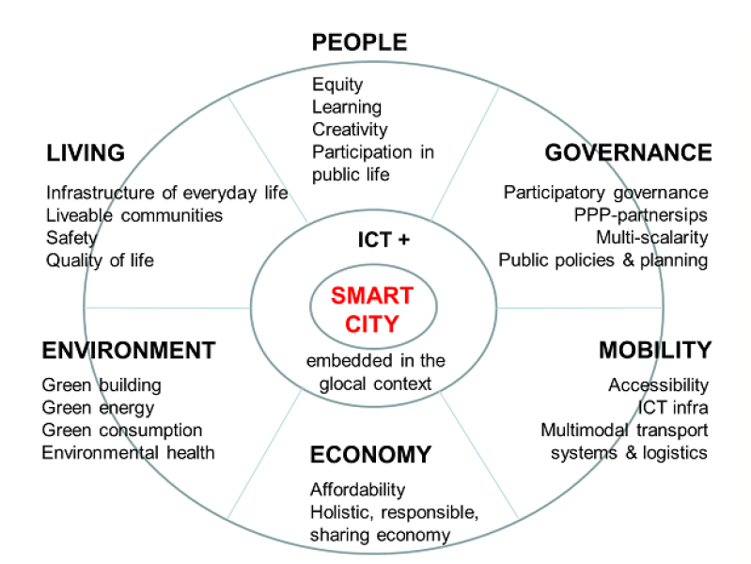
Smart Cities Wheel Model

Slide 6
Overview of the goals of a Smart City
Economical | Environmental | Social
To Cultivate Innovation and Start up Culture (Gopinath et al., 2008) Sustainable Commercial Development (City Branding) Encouraging sharing of existing resources and reducing emissions and creating infrastructure and investments for Electric and Autonomous Vehicles (Al-Kaisy, 2022) | Reduce CO2 Emissions drastically leading to slower down Climate Change (Le Quéré et al., 2020) For e.g. To reduce 95% CO2 emissions in Oslo & Norway by 2030 (Bjerkan & Seter, 2021) Align with National Transport Plans, for e.g. To achieve Norway National Transport Plan 2018-2029 to be zero emission.(O’Born et al., 2018) | Improve quality of daily life for their citizens (R. P. Dameri, 2017) Community building and citizen engagement Providing customized services for inhabitants (or visitors) Value creation in tourist-oriented municipalities in regional Norway
Notes:
We also mention here KPI’s

Slide 7
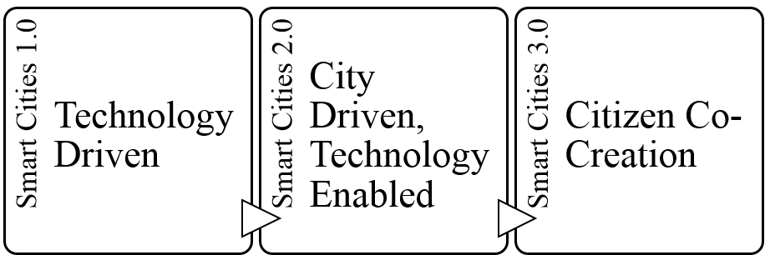
Different phases and evolution of Smart Cities

Slide 8
What is Smart Mobility
“the use of Information and Communication Technology in modern transport technologies to improve urban traffic”. (Albino et al., 2015).
“is a concept of comprehensive and smarter future traffic service in combination with smart technology. A Smart Mobility society is realized by means of the current intelligent traffic systems”. (Chun & Lee, 2015).
“local and supra-local accessibility, availability of ICTs, modern, sustainable and safe transport systems”. (Faria et al., 2017).
The aim is “Zero Emissions, Zero Accidents, Zero Ownership” (Neckermann, 2015).
+ Customized transport services
+ Improved Citizens’ accessibility to transport service

Slide 9
Mobility system
Economic/General trends
Mobility Demand
Mobility Service
Energy Infrastructure
Mobility Modality
Mobility Infrastructure

Slide 10
Smart Mobility system
Economic/General trends
Mobility Demand
Mobility Service
Energy Infrastructure
Mobility Modality
Mobility Infrastructure
ICT Infrastructure

Slide 11
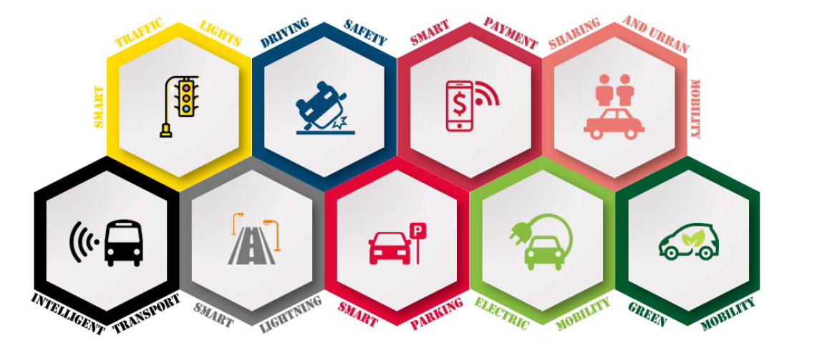
Dimensions of Smart Mobility
Source: Faria, R., Brito, L., Baras, K. & Silva, J. (2017). Smart mobility: a survey. In 2017 International Conference on Internet of Things for the Global Community (IoTGC).

Slide 12
Smart Mobility Stakeholders
Stakeholders for Smart Mobility
Users:
Inhabitants
Local businesses
Policy makers:
Government/ Local Municipalities
Technology Providers:
ICT Development Companies
Automotive Industry
Mobility Service Providers:
Taxi companies
Logistics' Companies
Other:
Research Institutes
Finance sector and investors

Slide 13
Trends influencing Smart Mobility
General Trends
Environmental Conscious Citizens
Hybrid Working Style
Aging Population
Specific Mobility Trends
Mobility as a Service
Shared Mobility
On-demand Transport
Green Mobility and Electric Vehicles
Autonomous Vehicles and Drones

Slide 14
Part 2: Business models for Smart Mobility

Slide 15
Business model definition
A business model is a company's core profit-making plan which defines the products or services it will sell, its target market, and any expected costs/Benefit.
A business model is a conceptual tool containing a set of objects, concepts, and their relationships with the objective to express the business logic of a specific organization (Osterwalder, 2005).
Notes:
A business model is an outline of how a company plans to make money with its product and customer base in a specific market.

Slide 16
The role and steps in Business Design

Slide 17
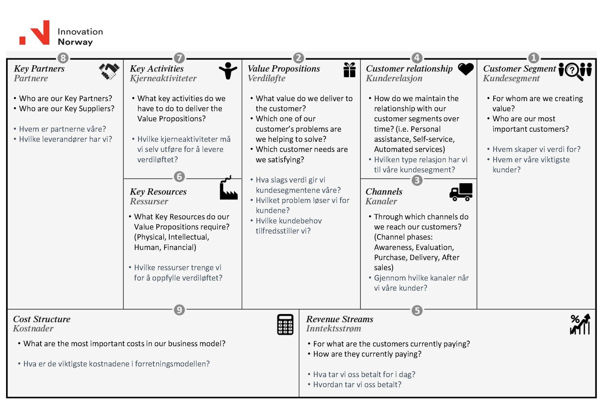
Business model Canvas

Slide 18
Business model Canvas
Value
Delivery
Value
Creation
Value
Capture

Slide 19
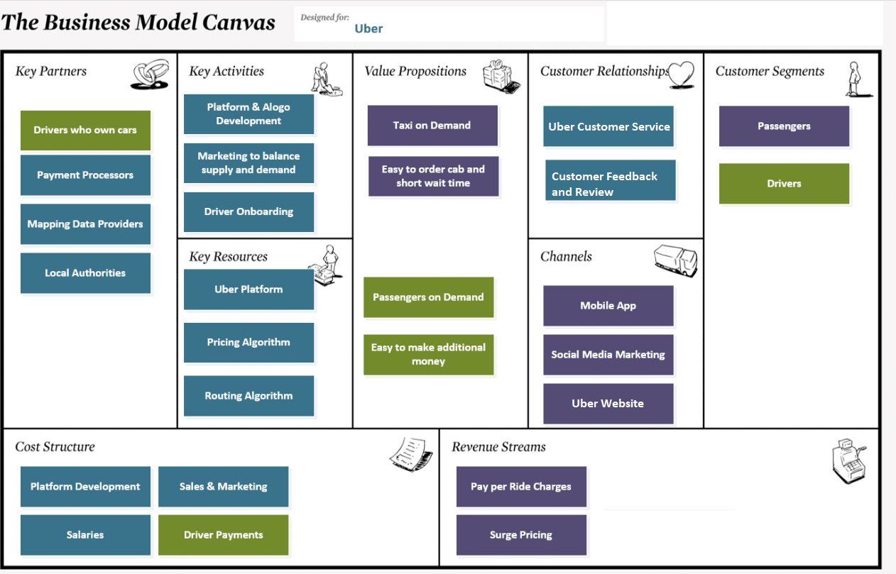
Business model Canvas: one example

Slide 20
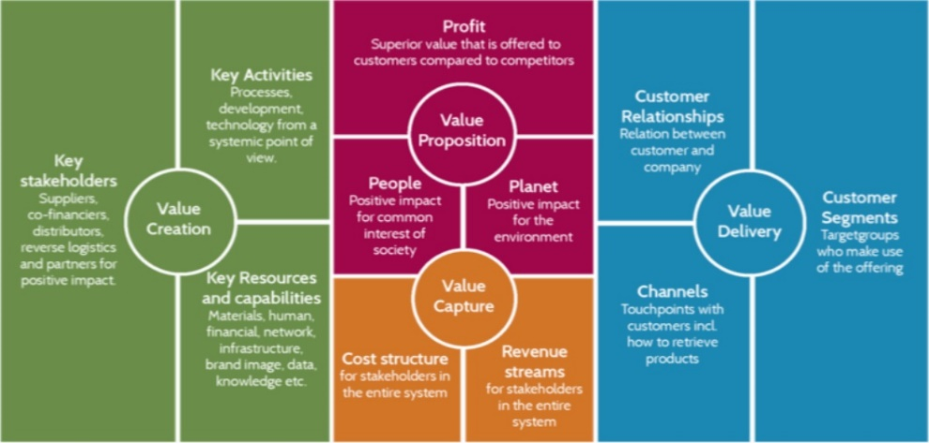
Sustainable Business Model Canvas

Slide 21
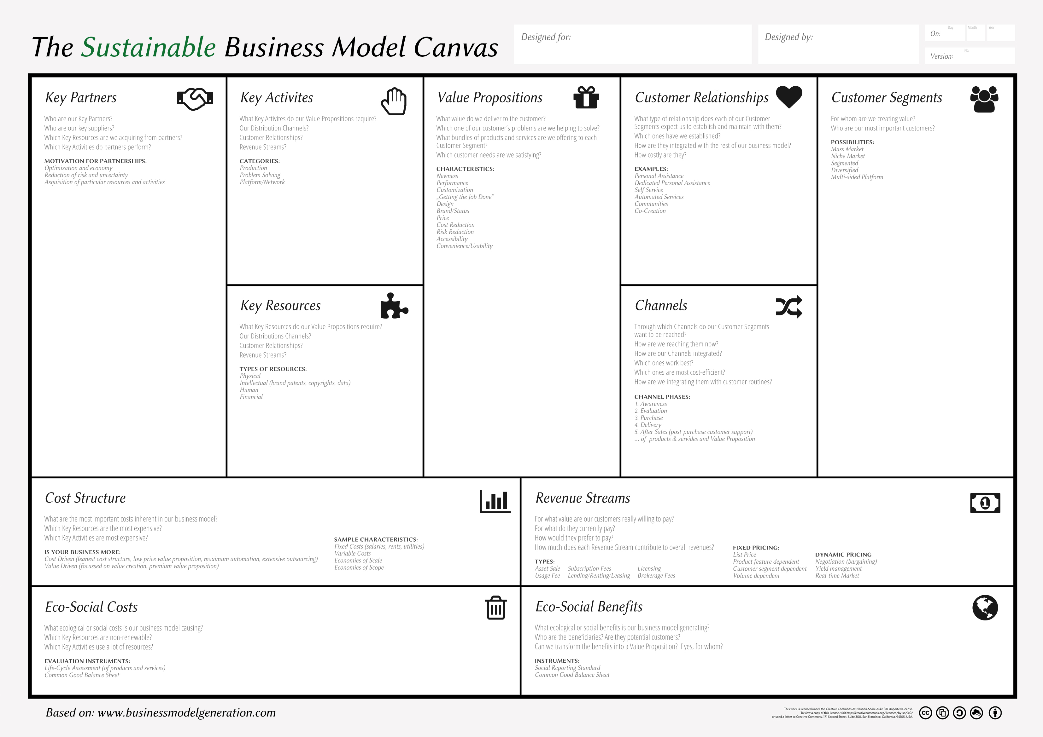
Sustainable Business Model Canvas
Source: the CASE project (Competencies for a sustainable socio-economic development)

Slide 22
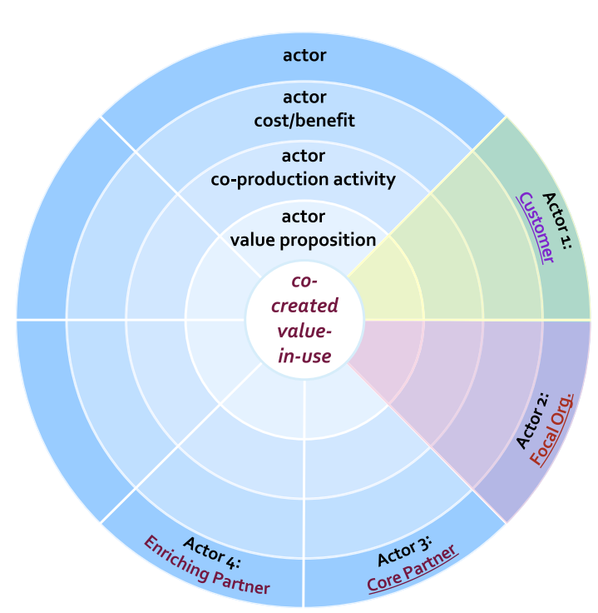
Service-dominant Business Model

Slide 23
Smart City Business Model
Key Actors Who are the smart city network key actors? (City, end-user, core partner, supporting partner) Who are the key suppliers? | Key Activities Which key activities are required to realize the value proposition? | Value Proposition What value does each actor deliver? Which of the end users’ problems does the smart city solution is going to solve? What are the respective target values-KPIs to be reached? |  | Actor Relationship What type of relationship does each actor expect within the network? Which ones are established? How are they integrated with the rest of our BM? | Network Beneficiaries What target users is the value created for? How the target users benefit from the value created and what are their needs? What specific values each network beneficiaries get?
Key Actors Offering (*) What offering does each actor deliver? | Key Resources and Infrastructure What key resources are required for to realize the value proposition? | Data (*) What data will be made available from the service designed? To whom and under what conditions? Availability and types of Open Data |  | Deployment and Channels Through which channels do our customers want to be reached? How are we reaching them now? How are our channels integrated? Which ones work best? Which ones are most cost efficient? How are they integrating with the customer routines?
Key Actors co-creation operation (*) Which key operations do the key actors perform?
Budget Cost What are the most important costs inherent for each actor deploying a smart city solution? Which key resources and key activities are the most expensive? What cost can be covered by each actor? Is there opportunity for blending public funding with private financing? |  |  | Revenue Stream For what value are the network beneficiaries being willing to pay? For what do they currently pay? How are they currently paying? How much would they prefer to pay? How much does each revenue stream contributing to overall revenues? Which actors have revenues? What are the non-monetary revenues?
Environmental Impacts: Costs and Benefits What is the ecological cost of the smart city solution? What is the ecological benefit of the smart city solution? The percentage of reducing energy consumption The percentage of reducing the environmental footprint |  |  | Social Impacts: Value and costs What is the negative social value created by the smart city solution? What is the positive social value generated by the smart city solution?

Slide 24
Smart Mobility Business Model Framework

Slide 25
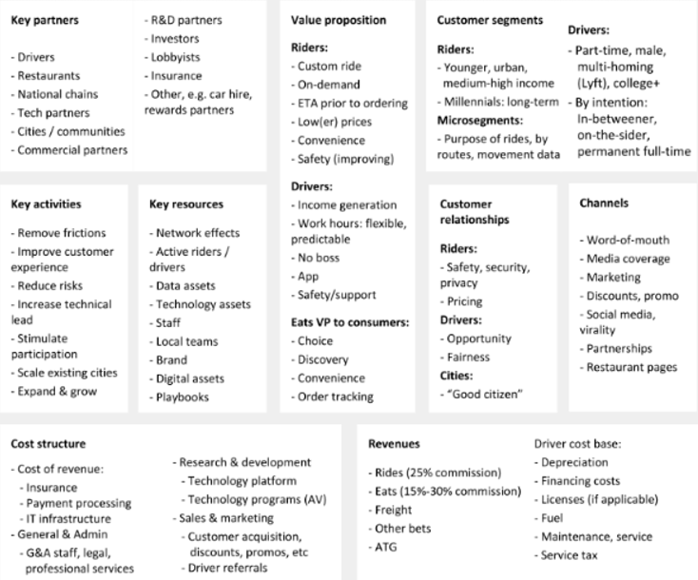
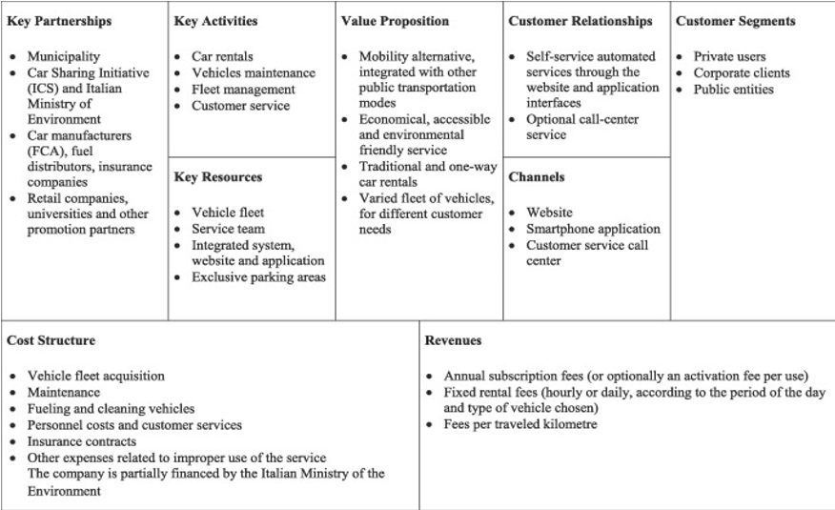
More examples of Smart Mobility Business Model
On-demand BM, Uber
Shared mobility BM, Car2go
Notes:
We can refer to the report here

Slide 26
Part 3: Evaluating business models for Smart Mobility

Slide 27
The Logic for Evaluating Smart Mobility Business Models
Smart mobility is not smart only because of its technical innovation
The organization should understand if the business model for the mobility solution is meant to be smart in the city ecosystem context
Therefore, the consistency of the BM building blocks should be analyzed into the city ecosystem perspective
A city ecosystem has enablers that affect timespan in which the Business model operates
A BM for smart mobility rely on a supportive city ecosystem to deliver its maximum value
A BM should objectively add value for the whole ecosystem

Slide 28
Smart City Ecosystems
Business ecosystems consist in multiple industries and the interactions occur among suppliers, customers, competitors, stakeholders and the like - named participants, whose capabilities influence one and all in the way they collaborate.
"In a business ecosystem, companies coevolve capabilities around a new innovation: they work cooperatively and competitively to support new products, satisfy customer needs, and eventually incorporate the next round of innovations" (Moore, 1993)
Cities are ecosystems where sustainability is maintained through the interactions of urban components. The different stakeholders perform a more active role: private sector participation is key in projects; citizens can interact directly to city officials and generate useful data coming from digital footprints, social media and crowd sourcing; Governments foster the collaboration of different actors (Díaz-Díaz, 2017)

Slide 29
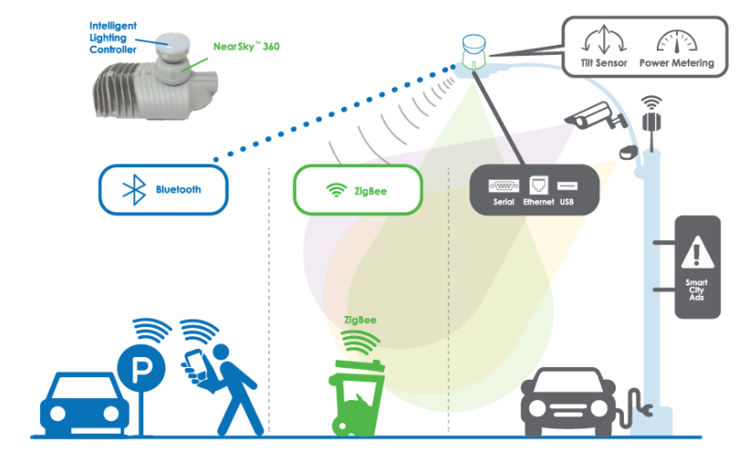
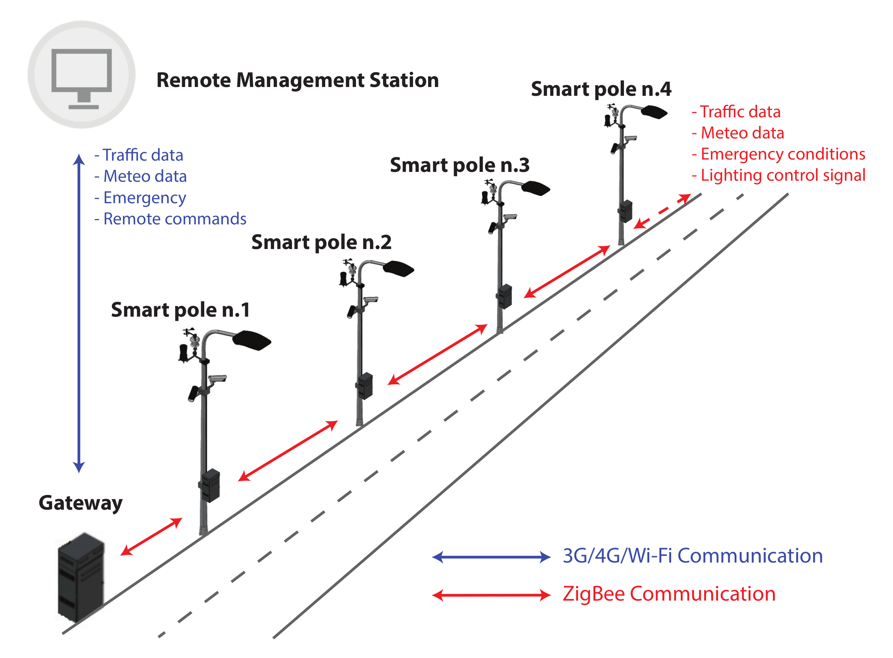
Smart City Ecosystems
Trend
https://ene-hub.com/offerings/products/smart-node/
http://www.smartercity.tech/smart-pole-node/
https://www.mdpi.com/2624-6511/3/4/71/htm

Slide 30
Smart City Ecosystems

Slide 31
Evaluation framework for Smart Mobility Business Models
The FM extends the traditional perspective of business models of delivering value for customer targets to delivering it to multiple-actors and natural environment of the city ecosystem.
It aims to evidence where the business model stands in the city ecosystem in a current and future state.

Slide 32
Evaluation framework for Smart Mobility Business Models

Slide 33
Evaluation framework for Smart Mobility Business Models

Slide 34
Evaluation framework for Smart Mobility Business Models
3 perspectives to look at:
The smartness of the offering (Y)
The city ecosystem key enablers (X)
The feedback loop zone (F)

Slide 35
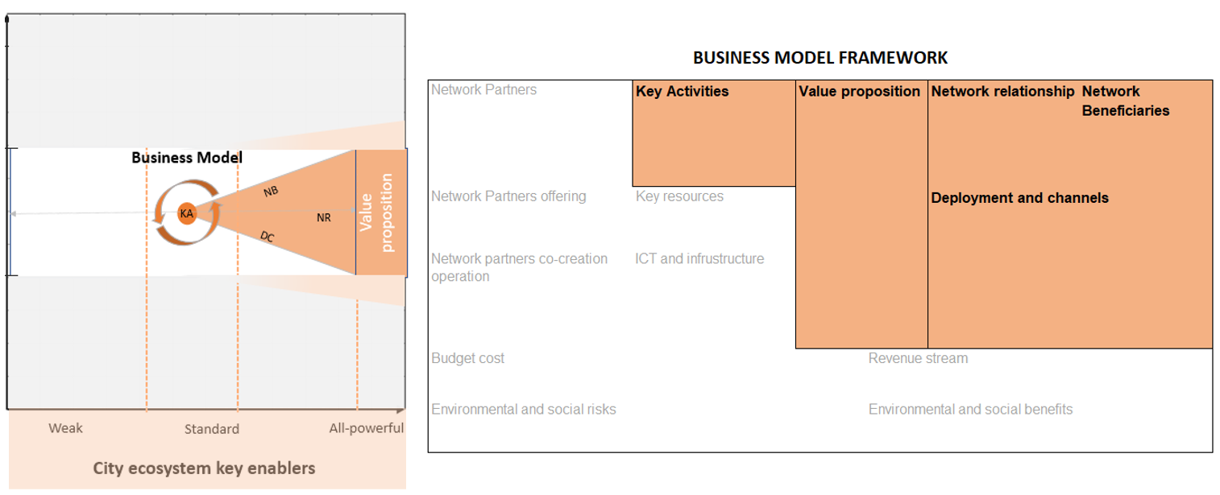
Evaluation framework for Smart Mobility Business Models
3 perspectives to look at:
The smartness of the offering (Y)
The city ecosystem key enablers (X)
The feedback loop zone (F)

Slide 36
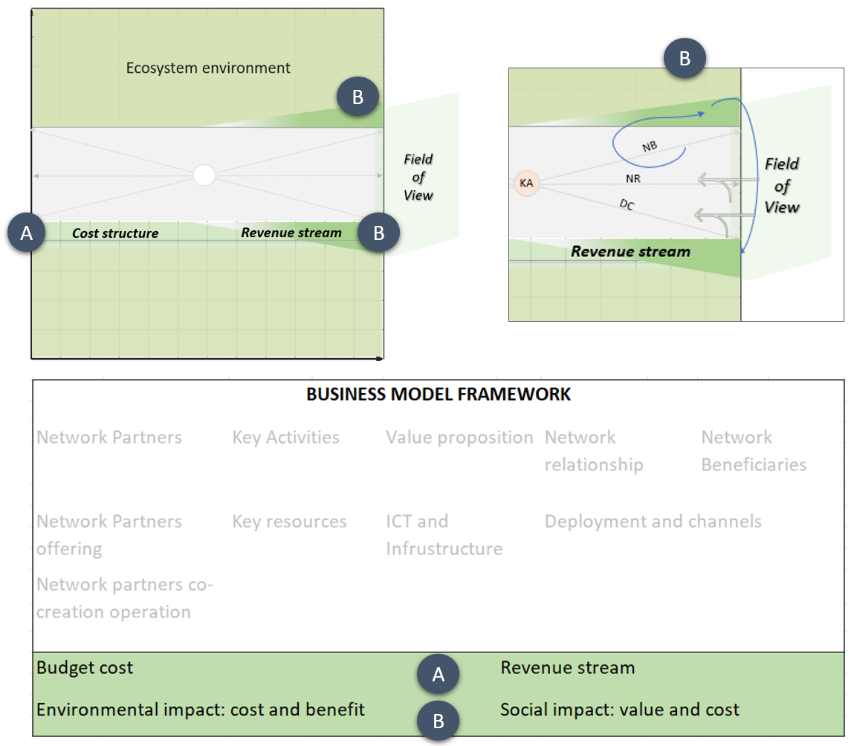
Evaluation framework for Smart Mobility Business Models
3 perspectives to look at:
The smartness of the offering (Y)
The city ecosystem key enablers (X)
The feedback loop zone (F)

Slide 37
The value dynamics and risks in the Evaluation framework

Slide 38
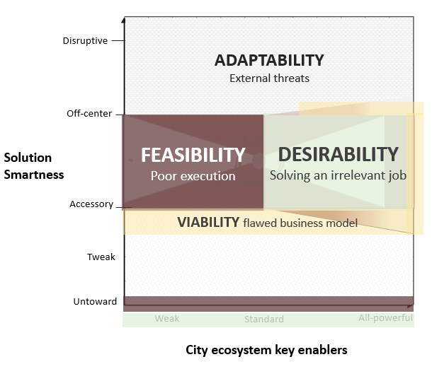
The value dynamics and risks in the Evaluation framework

Slide 39
The value dynamics and risks in the Evaluation framework
Identify BM progress into the city ecosystem, building blocks consistency and create perspective awareness of factors that impact the environment
Bring rationales of ecosystem innovation, social dynamics and governance.
Directing efforts in ICT development will give more chances to be greatly evaluated if the focus is to ameliorate community life.

Slide 40
Part 4: Next steps

Slide 41
Some possible next steps
Implementing the Business model blueprint for some on-going smart mobility projects in Norefjell
Analysing the city eco-system, identifying current capabilities and gaps, and providing suggestions for improvement
Evaluate existing and new smart city projects and initiatives against the ecosystem framework (to identify what is missing from the project plans and what is needed to make the projects fully successful).
Ensuring Engagement of Stakeholders in Smart City Projects (Stake-holder analysis) and developing a stakeholder engagement plan

Slide 42
Thanks for your attention! Behzad.Behdani@usn.no

